Slide 1

Title: Judicial Reforms in Bangladesh
Presented By
Name:Md. Junayed akanda showrav

Slide 2

Slide 2: Structural Reforms in the Judiciary
Establishment of Supreme Court Secretariat (via constitutional amendment)
Judicial Appointments Commission & Supreme Judicial Council rules
Decentralization: High Court judges at division, magistrates at Upazila
Bangladesh Attorney Service proposal
Reforms: Judicial staff recruitment rules, independent investigation agency
Legal aid expansion; JAO post creation
Amendments to Village Court, Mobile Court Acts
Reforms to Appellate Division Rules & lawyer conduct rules

Slide 3

Slide 3: Civil Justice System Reforms (Part 1
JAO appointment for administrative supervision
Faster summons via NID & digital verification
Mandatory submission of documents with plaint
Specific, timely replies required
Compulsory issue framing & discovery process

Slide 4
Slide 4: Civil Justice System Reforms (Part 2)
Settlement efforts initiated by courts
Daily testimony for faster resolution
Detailed appeal memoranda, extended limits
Verified pleadings accepted as evidence
Final hearing to include cost assessment in decree
Court-ordered compensation—limit removed
Punishment for fake documents/testimony

Slide 5
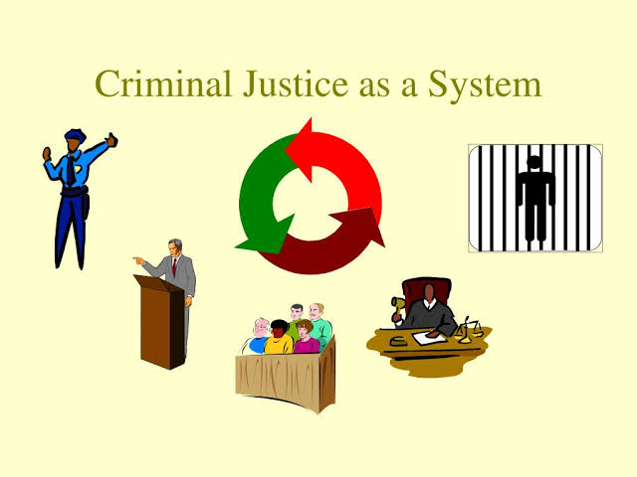
Slide 5: Criminal Justice System Reforms
Witness & victim protection law + protection cell
Security & expenses for victims/witnesses
Section 545 CrPC amendment
Compoundable offenses expanded (Section 143 Penal Code)
Probation or fine for minor crimes (<3 years)
Digital records now recognized as "documents"
Defined powers for "Justice of the Peace"
Introduction of plea bargaining
Peace-related hearing guidelines restored

Slide 6
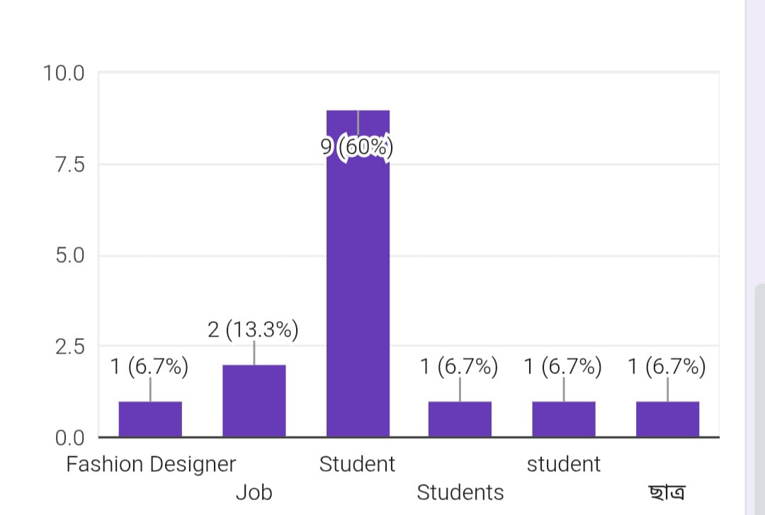
"Public Opinion Survey on Legal Reform"
https://docs.google.com/forms/d/1TFl8-XAOFGt-xbZa06Eez-j8A_lk0GKD0IT26-PvOK8/edit

Slide 7

Slide 7: Summary & Conclusion
Aims: Independent, impartial, timely, cost-effective judiciary
People’s right to fair justice ensured
Strengthens public trust
Meaningful judicial reform is achievable through implementation

